Slide 1
Segmentation
CSC 249/449 Spring 2019
http://www.cs.rochester.edu/~cxu22/t/249S19/
Instructor: Chenliang Xu
chenliang.xu@rochester.edu

Slide 2
Outline
What are grouping problems in vision?
Inspiration from human perception
Gestalt properties
Bottom-up segmentation via clustering
Mode finding and mean shift: k-means, SLIC, mean-shift
Graph-based: minimum spanning forest, normalized cuts (Thursday)
Differentiable segmentation

Slide 3
Grouping in vision
Goals:
Gather features that belong together
Obtain an intermediate representation that compactly describes key image or video parts

Slide 4
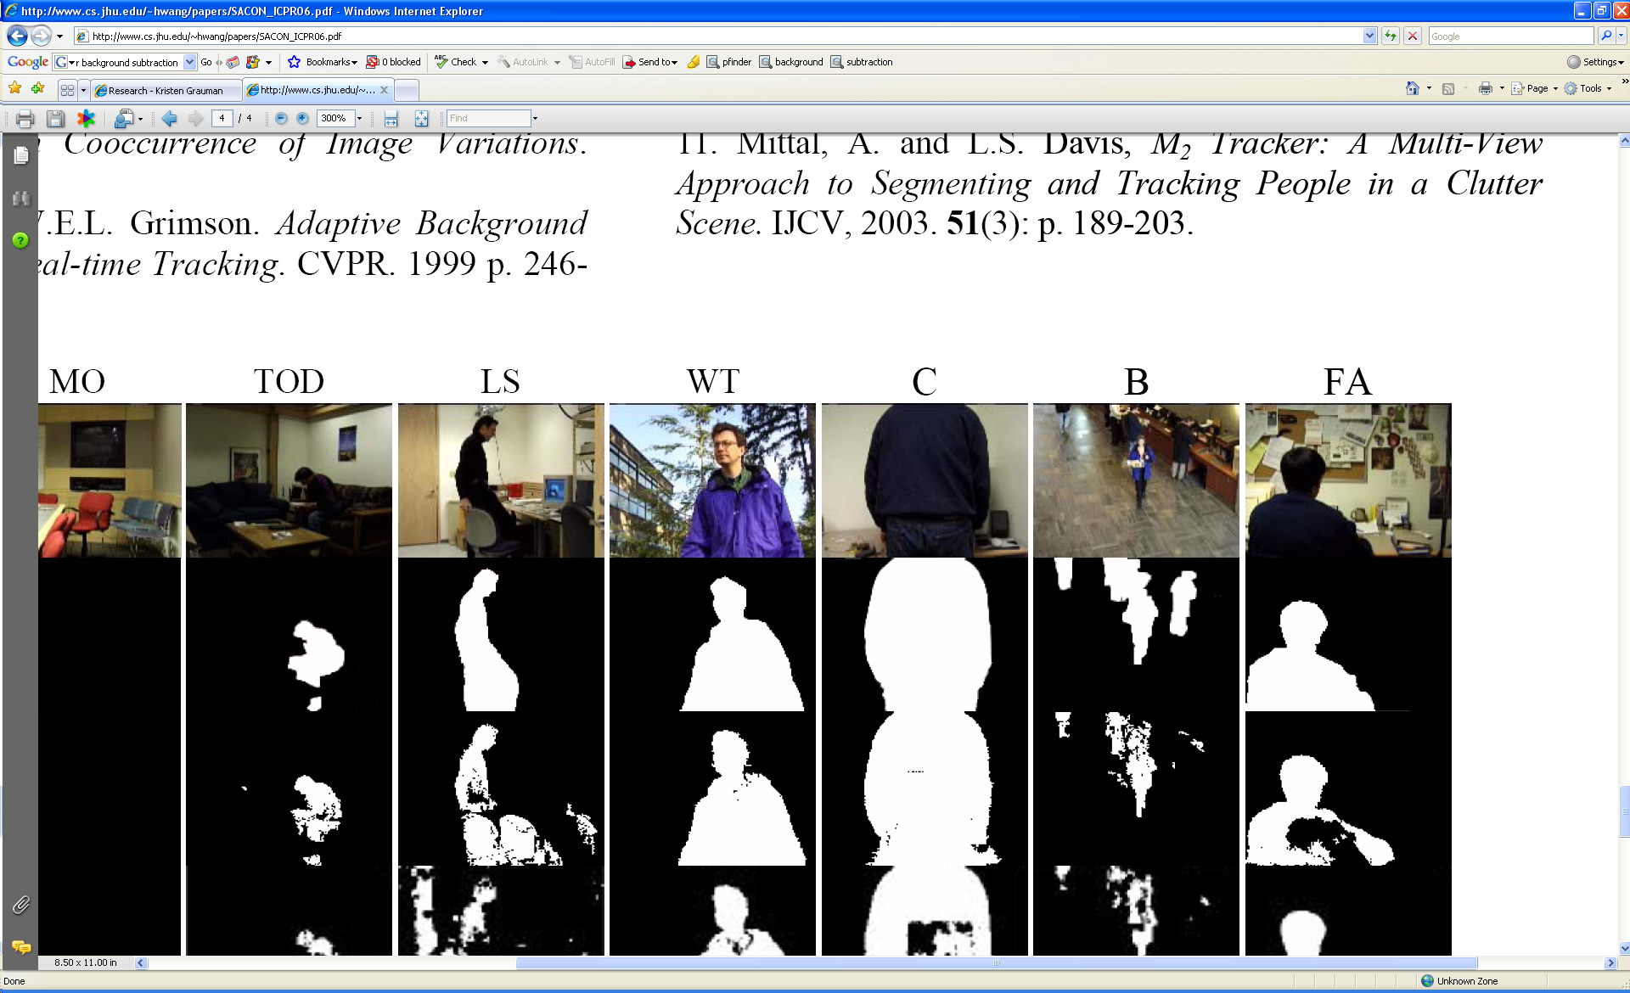
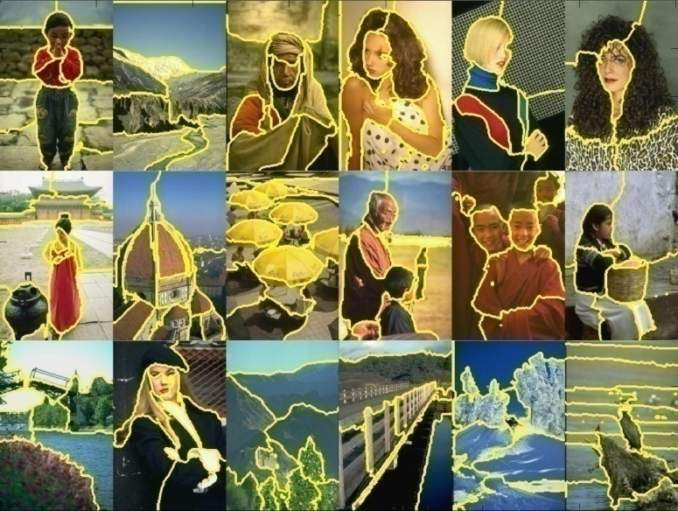
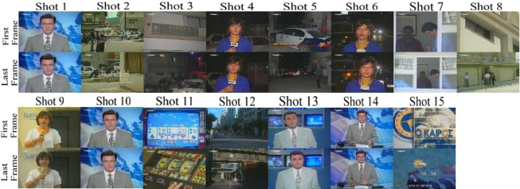
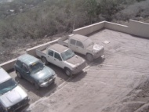
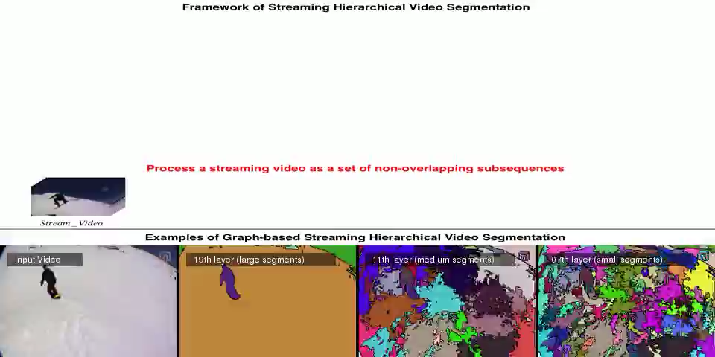
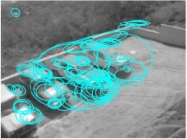
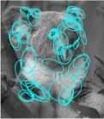
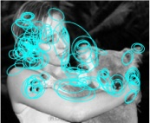
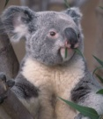
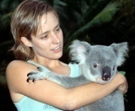
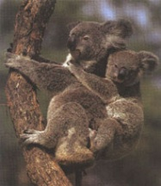
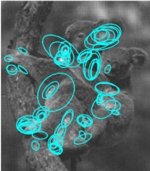
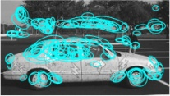
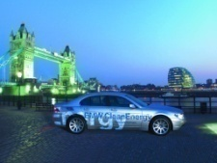
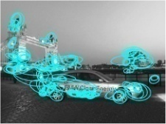



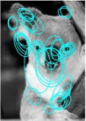
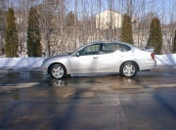
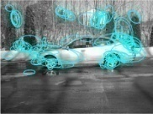
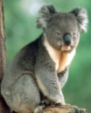
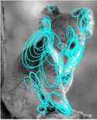
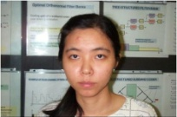
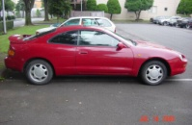
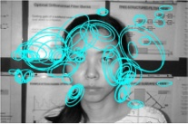
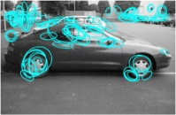
Examples of grouping in vision
[http://poseidon.csd.auth.gr/LAB_RESEARCH/Latest/imgs/SpeakDepVidIndex_img2.jpg]
Group video frames into shots
[Figure by Wang & Suter]
[Figure by J. Shi]
Figure-ground
Determine image regions
[Figure by Grauman & Darrell]
[Figure by Chenliang Xu]
Object-level grouping
Determine video regions
Notes:
4

Slide 5
Grouping in vision
Goals:
Gather features that belong together
Obtain an intermediate representation that compactly describes key image or video parts
Top down vs. bottom up segmentation
Top down: pixels belong together because they are from the same object
Bottom up: pixels belong together because they look similar
Hard to measure success
What is interesting depends on the app.

Slide 6
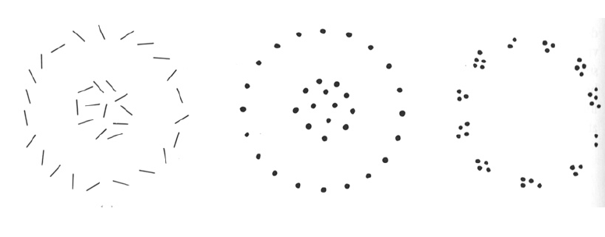
What are meta-cues for grouping?

Slide 7
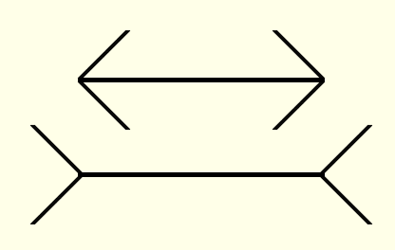
Muller-Lyer illusion
Gestalt principle: grouping key to visual perception.
Notes:
7

Slide 8
What things should be grouped? What cues indicate groups?

Slide 9
Gestalt
Gestalt: whole or group
Whole is greater than sum of its parts
Relationships among parts can yield new properties/features
Psychologists identified series of factors that predispose set of elements to be grouped (by human visual system)
Notes:
9

Slide 10
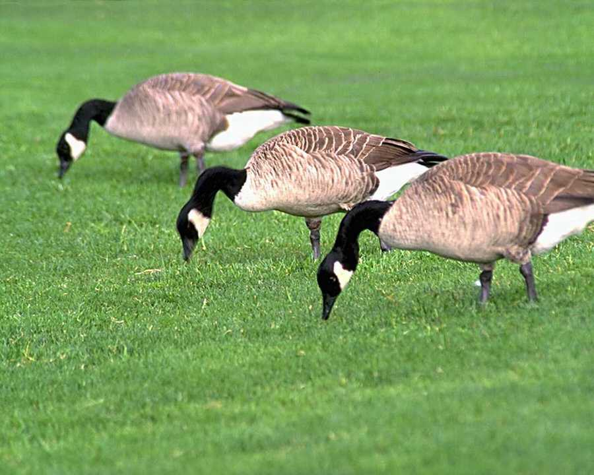
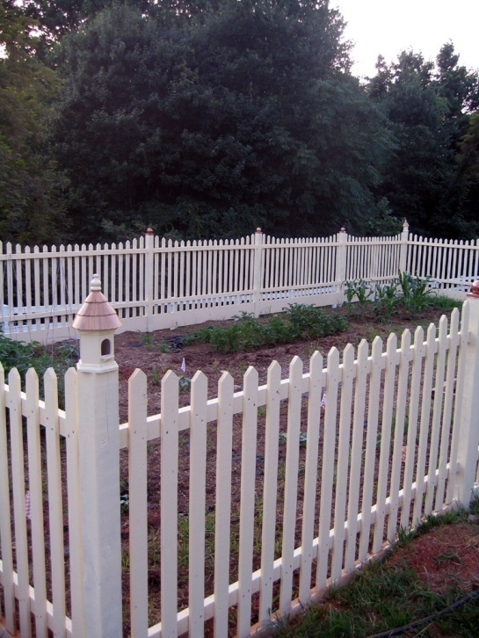
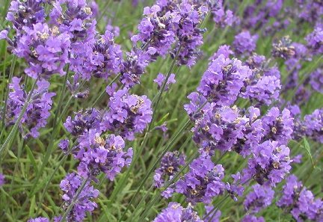
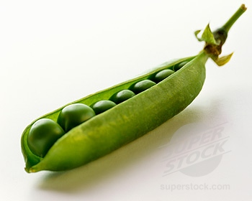
Similarity
Slide credit: Kristen Grauman
http://chicagoist.com/attachments/chicagoist_alicia/GEESE.jpg, http://wwwdelivery.superstock.com/WI/223/1532/PreviewComp/SuperStock_1532R-0831.jpg
Notes:
Similar tokens tend to be grouped together.

Slide 11
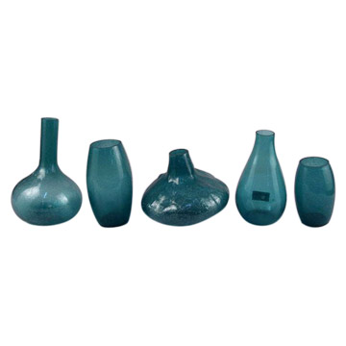
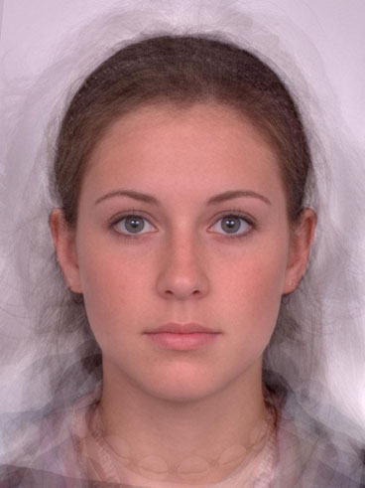
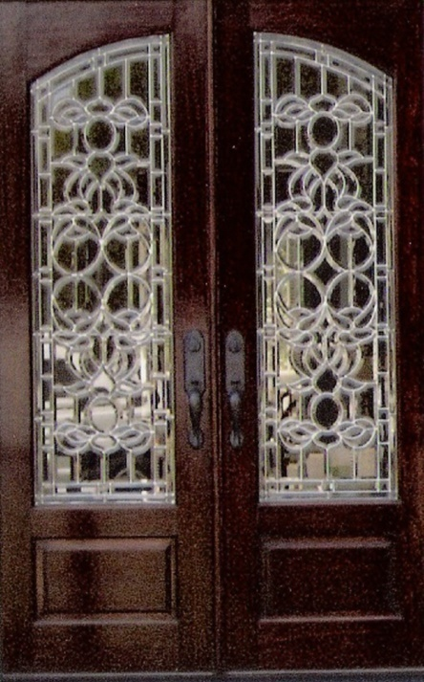
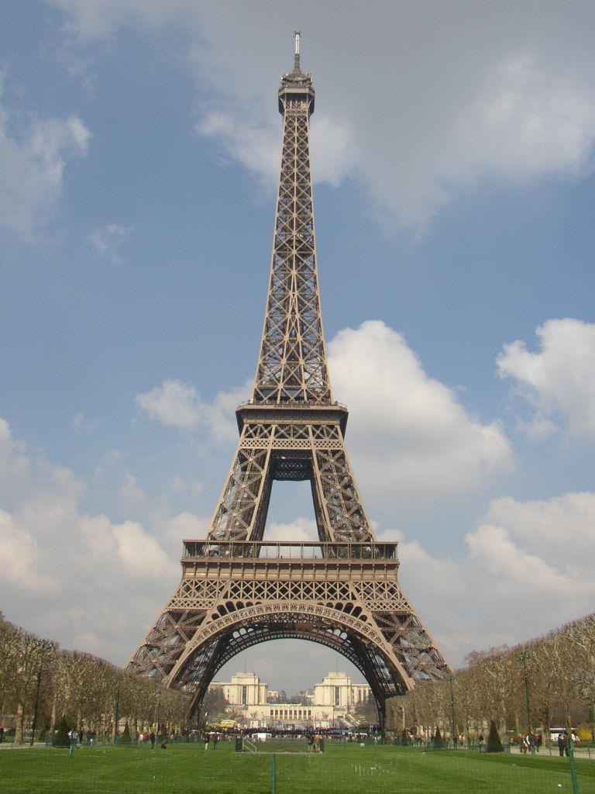
Symmetry
Slide credit: Kristen Grauman
http://seedmagazine.com/news/2006/10/beauty_is_in_the_processingtim.php

Slide 12
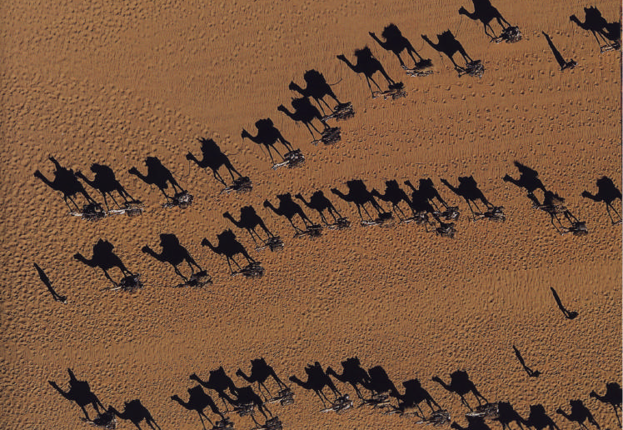
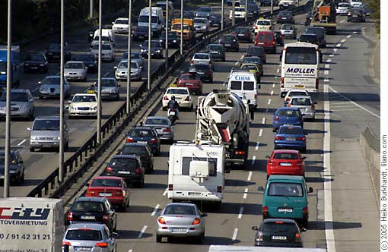
Common fate
Image credit: Arthus-Bertrand (via F. Durand)

Slide 13
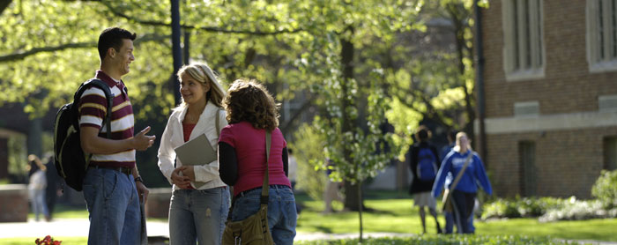

Proximity
Slide credit: Kristen Grauman
http://www.capital.edu/Resources/Images/outside6_035.jpg
Notes:
Tokens that are nearby tend to be grouped.

Slide 14
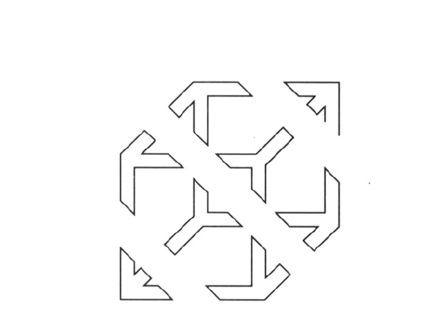

Slide 15
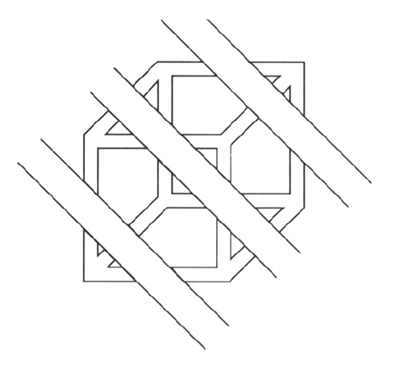
Continuity, explanation by occlusion

Slide 16
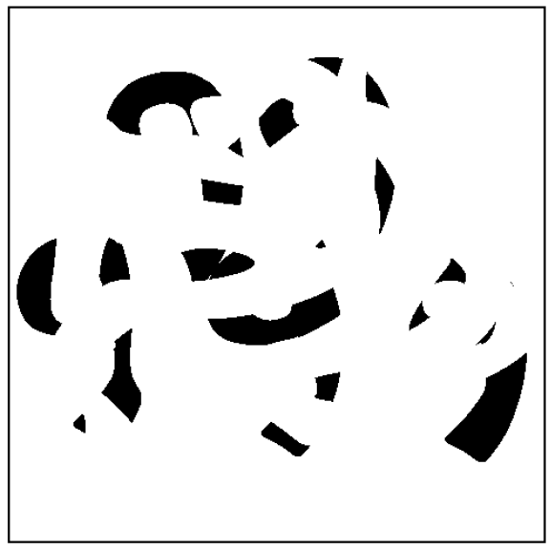
D. Forsyth

Slide 17
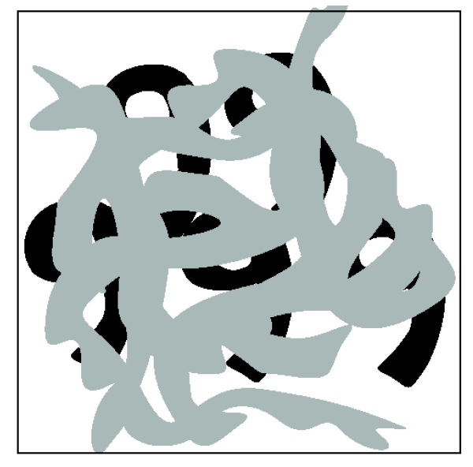
Continuity, explanation by occlusion

Slide 18
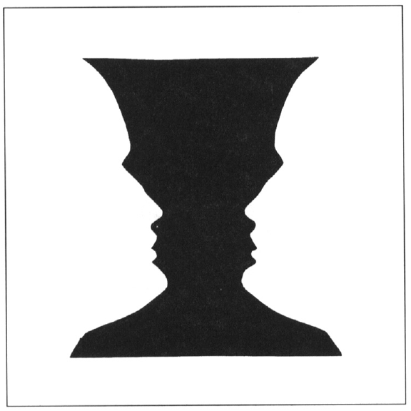
Figure-ground

Slide 19
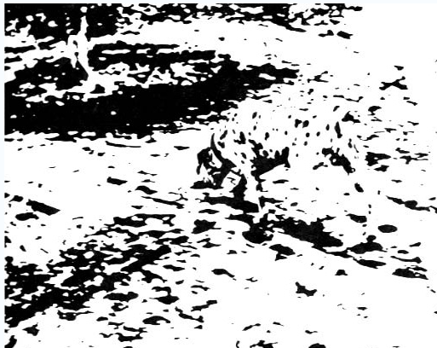
Notes:
19

Slide 20
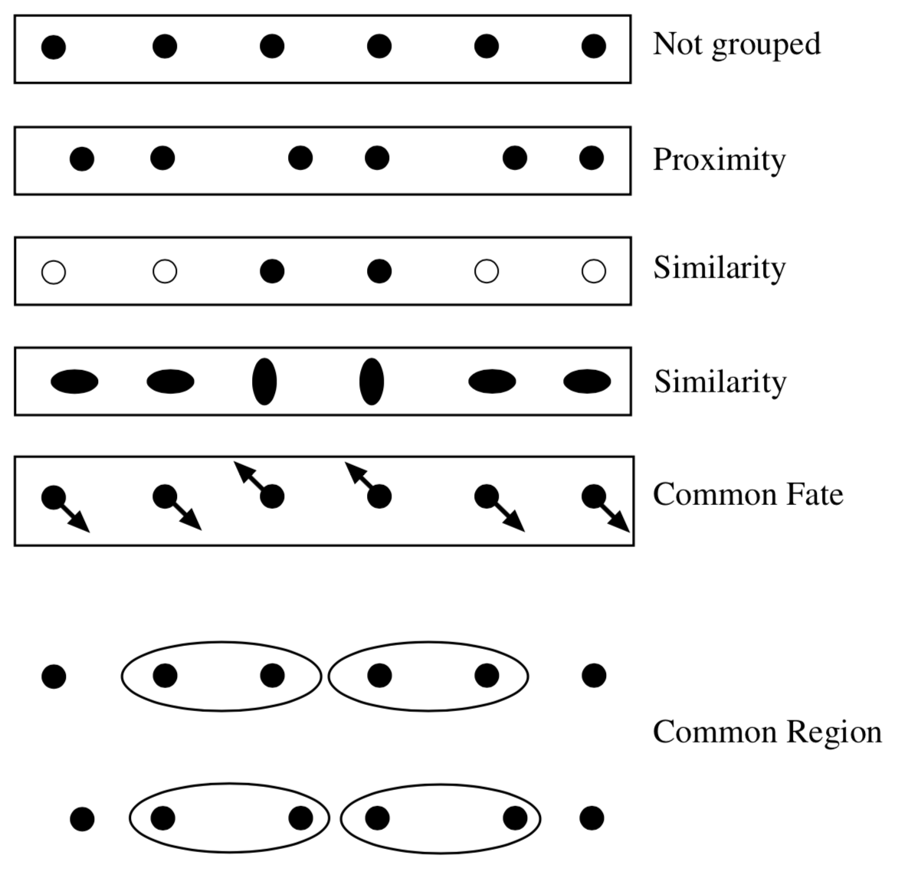
Gestalt factors that lead to grouping
Tokens that are nearby tend to be grouped.
Similar tokens tend to be grouped together.
Tokens that have coherent motion tend to be grouped together.
Tokens that lie inside the same closed region tend to be grouped together.

Slide 21
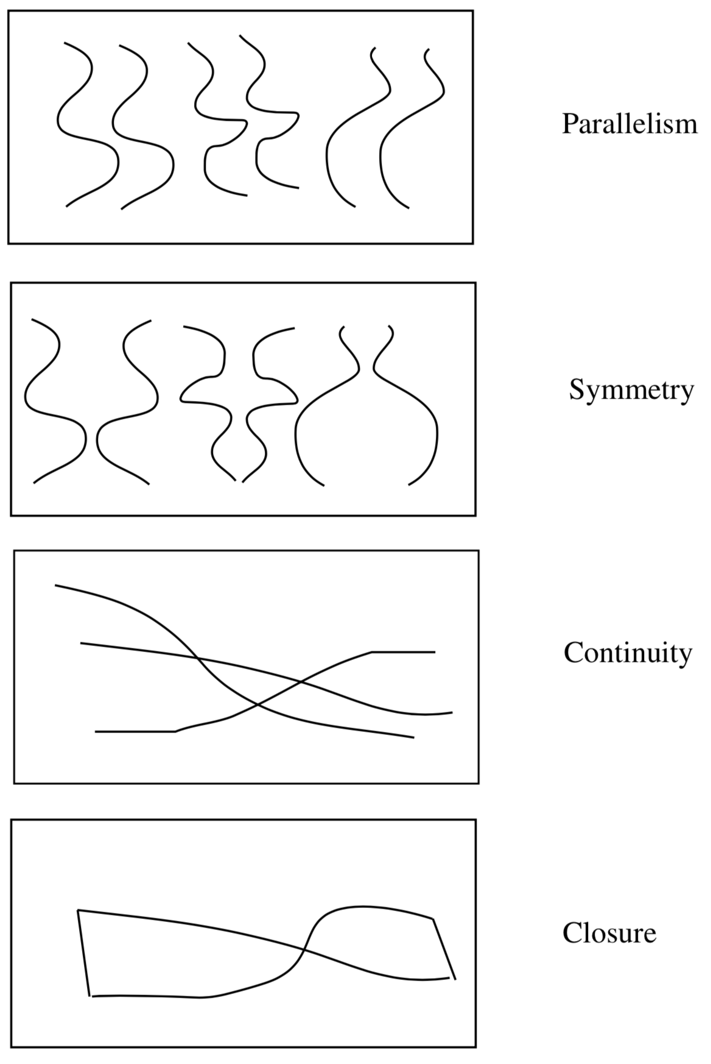
Gestalt factors that lead to grouping

Slide 22
Gestalt
Gestalt: whole or group
Whole is greater than sum of its parts
Relationships among parts can yield new properties/features
Psychologists identified series of factors that predispose set of elements to be grouped (by human visual system)
Inspiring observations/explanations; challenge remains how to best map to algorithms.
Notes:
22

Slide 23
Outline
What are grouping problems in vision?
Inspiration from human perception
Gestalt properties
Bottom-up segmentation via clustering
Mode finding and mean shift: k-means, SLIC, mean-shift
Graph-based: minimum spanning forest, normalized cuts
Differentiable segmentation

Slide 24
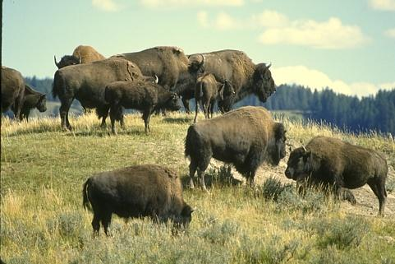
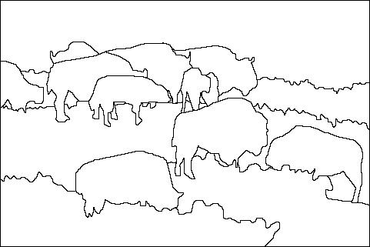
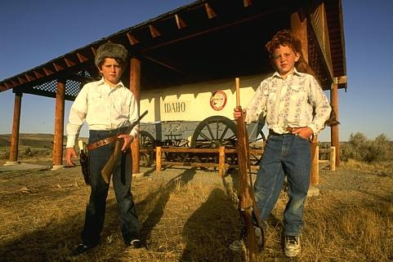
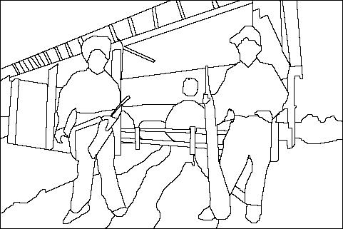
The goals of segmentation
Separate image into coherent “objects”
image
human segmentation
Source: Lana Lazebnik

Slide 25
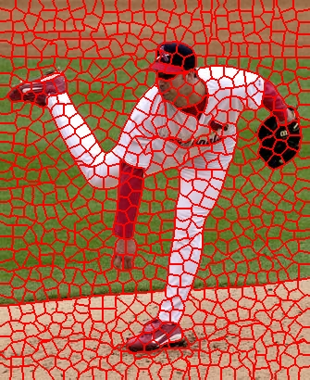

The goals of segmentation
Separate image into coherent “objects”
Group together similar-looking pixels for efficiency of further processing
“superpixels”
X. Ren and J. Malik. Learning a classification model for segmentation. ICCV 2003.
Source: Lana Lazebnik

Slide 26

Clustering
Clustering algorithms:
Unsupervised learning
Detect patterns in unlabeled data
E.g. group emails or search results
E.g. find categories of customers
E.g. group pixels into regions
Useful when don’t know what you’re looking for
Requires data, but no labels
Slide credit: Dan Klein

Slide 27


Image segmentation: toy example
white pixels
pixel count
3
black pixels
gray pixels
1
2
input image
intensity
These intensities define the three groups.
We could label every pixel in the image according to which of these primary intensities it is.
i.e., segment the image based on the intensity feature.
What if the image isn’t quite so simple?
Slide credit: Kristen Grauman

Slide 28


pixel count
input image
intensity
pixel count
input image
intensity
Slide credit: Kristen Grauman

Slide 29
pixel count
input image
intensity
Now how to determine the three main intensities that define our groups?
We need to cluster.
Slide credit: Kristen Grauman

Slide 30

0
190
255
intensity
3
1
2
Goal: choose three “centers” as the representative intensities, and label every pixel according to which of these centers it is nearest to.
Best cluster centers are those that minimize SSD between all points and their nearest cluster center ci:
Slide credit: Kristen Grauman

Slide 31
Clustering
With this objective, it is a “chicken and egg” problem:
If we knew the cluster centers, we could allocate points to groups by assigning each to its closest center.
If we knew the group memberships, we could get the centers by computing the mean per group.
Slide credit: Kristen Grauman

Slide 32
K-means clustering
Basic idea: randomly initialize the k cluster centers, and iterate between the two steps we just saw.
Randomly initialize the cluster centers, c₁, ..., c_{K}
Given cluster centers, determine points in each cluster
For each point p, find the closest c_{i}. Put p into cluster i
Given points in each cluster, solve for c_{i}
Set c_{i} to be the mean of points in cluster i
If c_{i} have changed, repeat Step 2
Properties
Will always converge to some solution
Can be a “local minimum”
does not always find the global minimum of objective function:
Source: Steve Seitz

Slide 33

K-Means
An iterative clustering algorithm
Pick K random points as cluster centers (means)
Alternate:
Assign data instances to closest mean
Assign each mean to the average of its assigned points
Stop when no points’ assignments change

Slide 34
Initialization
K-means is non-deterministic
Requires initial means
It does matter what you pick!
What can go wrong?
Various schemes for preventing this kind of thing
Slide credit: Dan Klein

Slide 35

K-Means Getting Stuck
A local optimum:
Slide credit: Dan Klein

Slide 36


K-means: pros and cons
Pros
Simple, fast to compute
Converges to local minimum of within-cluster squared error
Cons/issues
Setting k?
Sensitive to initial centers
Sensitive to outliers
Detects spherical clusters
Notes:
36

Slide 37
Probabilistic clustering
Basic questions
what’s the probability that a point x is in cluster m?
what’s the shape of each cluster?
K-means doesn’t answer these questions
Probabilistic clustering (basic idea)
Treat each cluster as a Gaussian density function
Slide credit: Steve Seitz

Slide 38
Expectation Maximization (EM)
A probabilistic variant of K-means:
E step: “soft assignment” of points to clusters
estimate probability that a point is in a cluster
M step: update cluster parameters
mean and variance info (covariance matrix)
maximizes the likelihood of the points given the clusters
Slide credit: Steve Seitz

Slide 39

Segmentation as clustering
Depending on what we choose as the feature space, we can group pixels in different ways.
Grouping pixels based on intensity similarity
Feature space: intensity value (1-d)
Slide credit: Kristen Grauman
Notes:
39

Slide 40



K=2
K=3
quantization of the feature space; segmentation label map
img_as_col = double(im(:));
cluster_membs = kmeans(img_as_col, K);
labelim = zeros(size(im));
for i=1:k
inds = find(cluster_membs==i);
meanval = mean(img_as_column(inds));
labelim(inds) = meanval;
end
Slide credit: Kristen Grauman

Slide 41

Segmentation as clustering
Depending on what we choose as the feature space, we can group pixels in different ways.
R=255
G=200
B=250
Grouping pixels based on color similarity
B
R=245
G=220
B=248
G
R=15
G=189
B=2
R=3
G=12
B=2
R
Feature space: color value (3-d)
Slide credit: Kristen Grauman
Notes:
41

Slide 42
Segmentation as clustering
Depending on what we choose as the feature space, we can group pixels in different ways.
Grouping pixels based on intensity similarity
Clusters based on intensity similarity don’t have to be spatially coherent.
Slide credit: Kristen Grauman
Notes:
42

Slide 43
Segmentation as clustering
Depending on what we choose as the feature space, we can group pixels in different ways.
Grouping pixels based on intensity+position similarity
Intensity
Y
X
Both regions are black, but if we also include position (x,y), then we could group the two into distinct segments; way to encode both similarity & proximity.
Slide credit: Kristen Grauman
Notes:
43

Slide 44



Segmentation as clustering
Color, brightness, position alone are not enough to distinguish all regions…

Slide 45

Segmentation as clustering
Depending on what we choose as the feature space, we can group pixels in different ways.
Grouping pixels based on texture similarity
F₁
F₂
Filter bank of 24 filters
…
F₂₄
Feature space: filter bank responses (e.g., 24-d)
Notes:
45

Slide 46

Image segmentation example
Slide credit: Kristen Grauman

Slide 47
Recall: K-means pros and cons
Pros
Simple, fast to compute
Converges to local minimum of within-cluster squared error
Cons/issues
Setting k?
Sensitive to initial centers
Sensitive to outliers
Detects spherical clusters
Notes:
47

Slide 48

Mean shift clustering and segmentation
An advanced and versatile technique for clustering-based segmentation
http://www.caip.rutgers.edu/~comanici/MSPAMI/msPamiResults.html
D. Comaniciu and P. Meer, Mean Shift: A Robust Approach toward Feature Space Analysis, PAMI 2002.

Slide 49

Mean shift algorithm
The mean shift algorithm seeks modes or local maxima of density in the feature space
Feature space
(L*u*v* color values)
image

Slide 50
Mean shift
Search window
Center of
mass
Mean Shift
vector
Slide by Y. Ukrainitz & B. Sarel

Slide 51
Mean shift
Search window
Center of
mass
Mean Shift
vector
Slide by Y. Ukrainitz & B. Sarel

Slide 52
Mean shift
Search window
Center of
mass
Mean Shift
vector
Slide by Y. Ukrainitz & B. Sarel

Slide 53
Mean shift
Search window
Center of
mass
Mean Shift
vector
Slide by Y. Ukrainitz & B. Sarel

Slide 54
Mean shift
Search window
Center of
mass
Mean Shift
vector
Slide by Y. Ukrainitz & B. Sarel

Slide 55
Mean shift
Search window
Center of
mass
Mean Shift
vector
Slide by Y. Ukrainitz & B. Sarel

Slide 56
Mean shift
Search window
Center of
mass
Slide by Y. Ukrainitz & B. Sarel

Slide 57

Mean shift clustering
Cluster: all data points in the attraction basin of a mode
Attraction basin: the region for which all trajectories lead to the same mode
Slide by Y. Ukrainitz & B. Sarel

Slide 58


Mean shift clustering/segmentation
Find features (color, gradients, texture, etc)
Initialize windows at individual feature points
Perform mean shift for each window until convergence
Merge windows that end up near the same “peak” or mode

Slide 59




Mean shift segmentation results
http://www.caip.rutgers.edu/~comanici/MSPAMI/msPamiResults.html

Slide 60

Mean shift segmentation results

Slide 61


Mean shift segmentation results

Slide 62
Mean shift
Pros:
Does not assume shape on clusters
One parameter choice (window size, aka “bandwidth”)
Generic technique
Find multiple modes
Cons:
Selection of window size
Does not scale well with dimension of feature space

Slide 63
Outline
What are grouping problems in vision?
Inspiration from human perception
Gestalt properties
Bottom-up segmentation via clustering
Mode finding and mean shift: k-means, SLIC, mean-shift
Graph-based: minimum spanning forest, normalized cuts
Differentiable segmentation

Slide 64

Superpixel Sampling Network (SSN)
Revisit SLIC
K-means clustering on pixels
For each iteration $t$ :
Pixel-Superpixel association: $H_{p}^{t}=\underset{i∈\{0,…,m−1\}}{\arg{min}} D(I_{p}, S_{i}^{t−1})$, where $H∈{\left\{0, 1, …, m−1\right\}}^{n×1}$ , $D\left(a,b\right)= {\left\|a−b\right\|}^{2}$
Superpixel center update: $S_{i}^{t}=\frac{1}{Z_{i}^{t}} \sum_{p|H_{p}^{t}=i}{I_{p}}$, where $Z_{i}^{t}$ denotes the number of pixels in the superpixel cluster $i$.
Why SLIC is not differentiable?
Because Pixel-Superpixel association $H$ is computed by non-differentiable nearest neighbor operation.
How to make it differentiable?
Use soft-assignment $Q∈ℝ^{n×m}$ to replace $H$

Slide 65

Superpixel Sampling Network (SSN) (cont’d)
SSN Algorithm

Slide 66

Superpixel Sampling Network (SSN) (cont’d)
How to train the network without superpixel ground-truth?
Learning Task-Specific Superpixels
Task-specific reconstruction loss
$L_{recon}=ℒ\left(R, R^{∗}\right)= ℒ(R, \tilde{Q}{\hat{Q}}^{T}R)$,
where $R∈ ℝ^{n×l}$ denotes pixel properties (semantic label, optical flow map). Here, ${\breve{R}=\breve{Q}}^{T}R$ is “mapping the pixel properties onto superpixels using the column-normalized association matrix”. Then, $\breve{R}$ is mapped back to pixel representation ($R^{∗}= \tilde{Q}\breve{R}$).
Compactness loss
$L_{compact}= {\left\|I^{xy} −{\overline{I}}^{xy}\right\|}^{2}$,
where $I^{xy}$ denotes positional pixel features and ${\overline{I}}^{xy}$ denotes $S_{i}^{xy}|H_{p}=i$ (assigning the same superpixel positional feature to all the pixels belonging to that superpixel).

Slide 67

Superpixel Sampling Network (SSN) (cont’d)
Computation flow of SSN

Slide 68

Superpixel Sampling Network (SSN) (cont’d)
Examples of superpixel

Slide 69

Superpixel Sampling Network (SSN) (cont’d)

Slide 70

Bilateral Inceptions
How to use superpixel in semantic segmentation?
Intuition: Pixels which are similar in location and appearance tend to have the same label.
Use superpixel to project the deep feature map (usually smaller) into original size.
R. Gadde, V. Jampani, M. Kiefel, D. Kappler, and P. Gehler. Superpixel convolutional networks using bilateral inceptions. In European Conference on Computer Vision. Springer, 2016.

Slide 71
Next lecture
Image as graph
Graph based segmentation methods
Video segmentation methods

